Slide 1
Technical Exercise Part 2- Mule API and Application
Victor Ho

Slide 2
Agenda
Introduction
Foody Web App - SPA
Architecture Overview
Foody APIs
Login Flow
https://github.com/victorho33/part2

Slide 3
Introduction
At Foody, we provide the best collection of local snack to food lovers who can buy online anytime. By closing the loop and leveraging the same day delivery, we help food supplier’s business grow foster and serving a consumer first mindset.

Slide 4
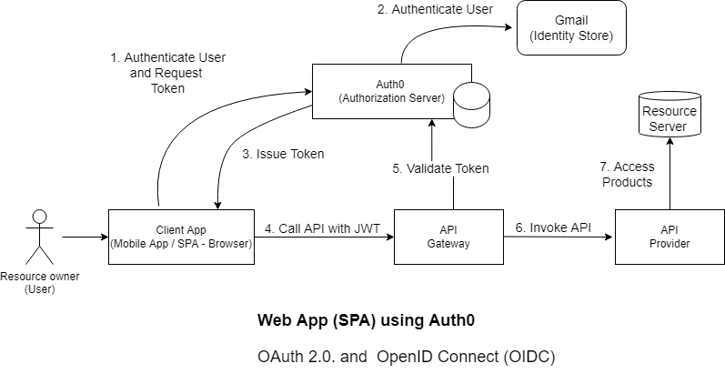
Foody Web App - Single Page Application (OAuth and OIDC with Auth0)

Slide 5











Architecture Overview
Foody
Backend API
AWS Cloud
VPC
Foody
Web App
MySQL instance

Slide 6
Foody APIs
https://foodyproductapp.us-e2.cloudhub.io/api/products
GET – Retrieve the list of product available
https://foodyauthapp.us-e2.cloudhub.io/auth/login
POST – Create login audit history
https://foodyauthapp.us-e2.cloudhub.io/auth/customers
GET – Retrieve the list registered customers (queryParameter : email address)
POST - Create customer record
https://foodyauthapp.us-e2.cloudhub.io/auth/email
POST – Send a welcome email to newly registered customer

Slide 7
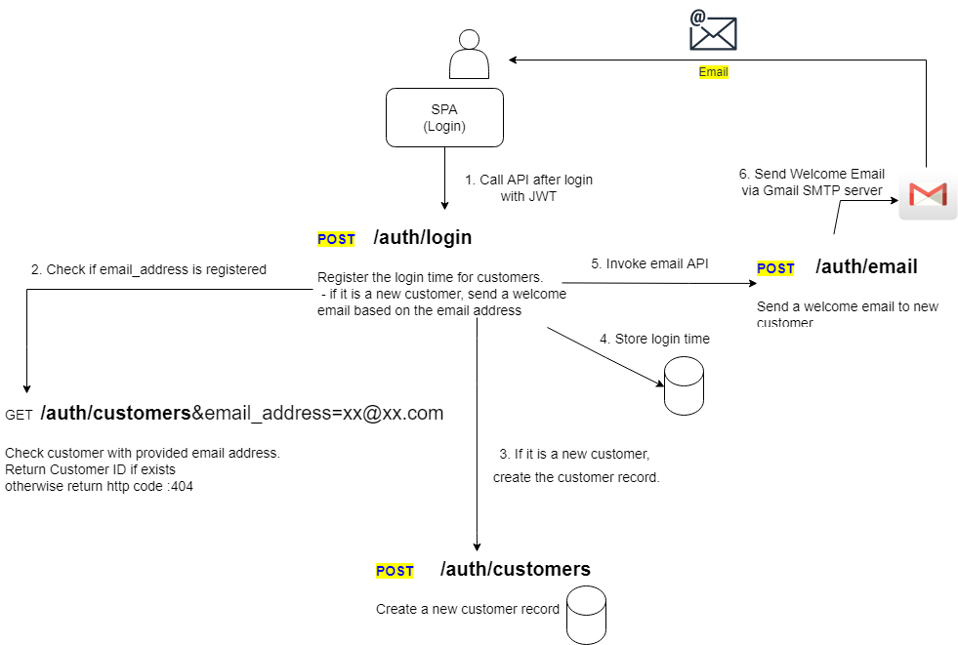
Login flow

Slide 8
Thank you

Slide 9
How to start the Web Application > npm cache clean > npm install > npm run dev Open web browser with URL http://localhost:3000

